Slide 1
Advanced operating System
Unit-2
Process, Threads and Deadlock

Slide 2
What is process?
A process is basically a program in execution. The execution of a process must progress in a sequential fashion
A program is an inanimate entity; only when a processor breathes life into it does it become the active entity, we call a process.
A process is the unit of work in a modern time-sharing system
Component of process are:
Object program
Data
Resource
Status of process execution

Slide 3
Programs and Processes
A process is different than a program. Consider the following analogy
Scenario-1: A computer scientist is baking a birthday cake for his daughter
Computer scientist Birthday cake recipe Ingredients Activities:
reading the recipe
fetching the ingradients
backing the cake
CPU
program
input data
processes

Slide 4
Programs and Processes
Scenario-2: Scientist's son comes running in crying, saying he has been stung by a bee.
Scientist records where he was in the recipe
Reach first aid box and materials
Follow the first aid action (high priority job)
On completion of aid, cake baking starts again from where it was left
- the state of running process saved
- Another process fetched
- Processor switched for new process
- Completion of high priority
job & return back to the last one
A process is an activity of some kind, it has program, input, output and state.

Slide 5
Programs and Processes
A process is different than a program.
Process | Program
Process is sequence of information execution | Program is a set of instruction
Process is dynamic object | Program is static object that exist in file
Process is loaded into main memory | It is loaded into the secondary storage device
Time span of process is limited. | Time span of program is unlimited
Process is an active entity | Program is passive entity

Slide 6

Process State
A process goes through a series of discrete process states.

Slide 7
As a process executes, it changes state
New: A process that just been created.
Ready: Ready processes are waiting to have the processor allocated to them by operating system so that they can run.
Running: The process that is currently being executed. A running process possesses all the resources needed for its execution, including the processor.
Waiting : A process that can not execute until some event occurs such as the completion of an I/O operation. The running process may become suspended by I/O module
Terminated: A process terminates when it finishes executing its last statement.

Slide 8
Process state transitions
When a job is admitted to the system, a corresponding process is created and normally inserted at the back of the ready list.
When the CPU becomes available, the process is said to make a state transition from ready to running.
ready -> running.
To prevent any one process from monopolizing the CPU, OS specify a time period(quantum) for the process. When the quantum expire or interrupt to CPU makes state transition running to ready.
running -> ready.
When the process requires an I/O operation before quantum expire or interrupt, the process voluntarily relinquishes the CPU and changed to the wait state.
running -> wait.
When an I/O operation completes. The process make the transition from wait state to ready state.
wait -> ready.
When process finished execution it will terminated

Slide 9
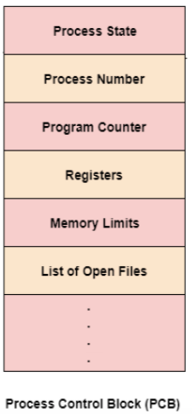
Process Control Block
The PCB is the data structure containing certain important information about the process -also called process table or processor descriptor.
Process Id: Each process is given Id number at the time of creation.
Process state: running, ready, blocked.
Program counter: Address of next instruction for the process.
Registers: Stack pointer, accumulator, indexed register etc.
Scheduling information: Process priority, pointer to scheduling queue etc.
Memory-allocation: value of base and limit register, page table, segment table etc.
Accounting information: time limit, process numbers etc.
Status information: list of I/O devices, list of open files etc.

Slide 10

CPU switch from process to process

Slide 11
Operations on Processes
The processes in the system can execute concurrently, and they must be created and deleted dynamically.
OS provide the mechanism for process creation and termination.
Process Creation.
Process creation is a task of creating new processes.
There are four principal events that cause the process to be created
System initialization.
Execution of a process creation system call.
User request to create a new process.
Initiation of a batch job.

Slide 12
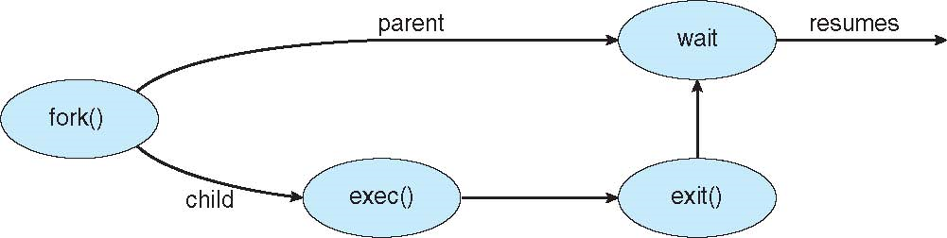
A process may create several new processes forming tree of process during the course of execution.
The creating process is called a parent process, where as the new processes are called children of that process.
UNIX examples: fork system call creates new process exec system call

Slide 13
Unix Process Creation Example
#include<stdio.h>
int main(int argc, char *argv[])
{
int pid;
pid = fork(); /* create new process */ if(pid < 0) { /* error occurred */
fprintf(stderr, “fork failed”);
return 1;
}
else if(pid == 0){ /* child process */ execlp(“/bin/ls”, “ls”, Null);
}
else { /* parent process */
wait(Null);
printf(“Child Complete”); exit(0);
}
return 0;
}

Slide 14
Process Termination:
Process termination is an operation in which a process is terminated after the execution of its last instruction.
When a process is terminated, the resources that were being utilized by the process are released by the operating system.
Process are terminated on the following conditions
1. Normal exit.
A process terminates when it finishes executing its final statement and asks the OS to delete it by using the exit system call.
2. Error exit.
An error caused by the process, often due to a program bug
3. Fatal error.
no such file exists during the compilation.
4. Killed by another process.
A process can cause the termination of another process via kill system call.

Slide 15
Interprocess Communication
Processes executing concurrently in the operating system may be either independent processes or cooperating processes.
A process is independent if it cannot affect or be affected by the other processes executing in the system.
Any process that does not share data with any other process is independent.
A process is cooperating if it can affect or be affected by the other processes executing in the system.
Clearly, any process that shares data with other processes is a cooperating process.

Slide 16
Reasons for cooperating processes:
Information sharing
Computation speedup
Modularity
Convenience
Cooperating processes need intercrosses communication (IPC)
Two models of IPC
Shared memory
Message passing

Slide 17
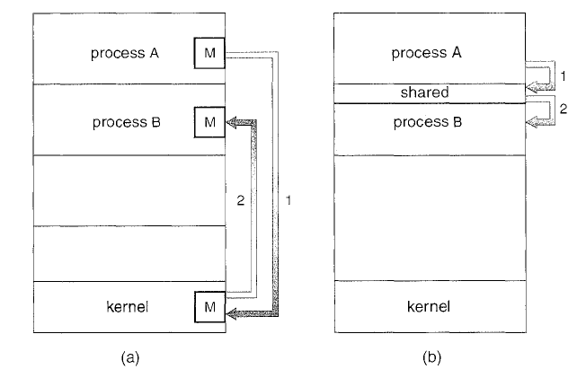
(a) Message passing. (b) shared memory.

Slide 18
Shared Memory System
Interprocess communication using shared memory requires communicating processes to establish a region of shared memory.
Typically, a shared-memory region resides in the address space of the process creating the shared-memory segment.
Other processes that wish to communicate using this shared-memory segment must attach it to their address space.
They can then exchange information by reading and writing data in the shared areas.
The form of the data and the location are determined by these processes and are not under the operating system’s control.
The processes are also responsible for ensuring that they are not writing to the same location simultaneously.

Slide 19
Shared Memory: Example Producer Consumer problem
Suppose one process, producer, is generating information that the second process, consumer, is using.
#define N = 100 int count = 0;
/* number of slots in the buffer*/
/* number of item in the buffer*/
void producer(void)
void consumer(void)
{
int item;
{
int item;
while(TRUE){ /* repeat forever*/
item = produce_item(); /*generate next item*/ if (count == N) sleep(); /*if buffer is
full go to sleep*/
insert_item(item); /* put item in buffer */ count = count +1; /*increment count */
if (count == 1) wakeup(consumer);
/* was buffer empty*/
}
}
while(TRUE){ /* repeat forever*/
if(count == 0)sleep(); /* if buffer is
empty go to sleep*/ item = remove_item(); /*take item out
of buffer*/
count = count -1; /*decrement count*/ if (count == N-1)wakeup(producer);
/*was buffer full ?*/
consume_item(); /*print item*/
}
}
What happened when consumer try to consume the item before producer produce it?

Slide 20
Message Passing System
Message passing provides a mechanism to allow processes to communicate and to synchronize their actions without sharing the same address space
Used for distributed environment
A message-passing facility provides at least two operations:
send(message) receive(message)
If processes P and Q want to communicate, they must send messages to and receive messages from each other: a communication link must exist between them.
The send() and receive() primitives are defined as:
• send(P, message)—Send a message to process P.
• receive(Q, message)—Receive a message from process Q.

Slide 21
Multithreading
What is Thread?
A thread is a path of execution within a process. A process can contain multiple threads
A thread is a flow of execution through the process code, with its own program counter, system register and stack
A thread is also called light weight process exist within process.
Threads provide a way to improve application performance through parallelism
Each thread belong to exactly one process and no thread can exist outside a process.
A traditional/ heavy weight process has a single thread of control.
If a process has multiple threads of control, it can perform more than one task at a time

Slide 22
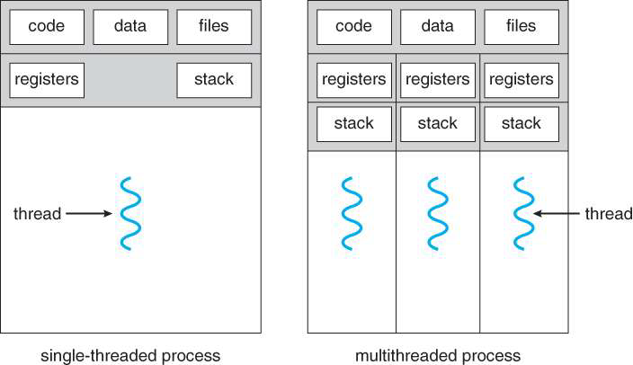
It shares with other threads belonging to the same process its code section, data section and other operating-system resources such as open files and signal
Single threaded process and Multi-threaded Process

Slide 23
Multithreading Benefits
In modern operating system multithreading has several benefits as :
• Responsiveness – program can run continuously even if the part of it is blocked
• Resource Sharing – Share the code and data
• Economy – economic in resources and context switching
• Scalability – supports multiprocessor architecture that increase concurrency

Slide 24
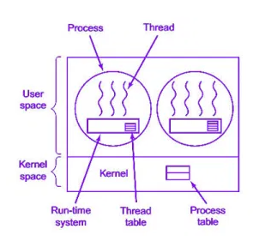
Users and Kernel Threads
User Threads:
Thread management done by user-level threads library.
Implemented as a library
Library provides support for thread creation,
scheduling and management with no support from the kernel.
Fast to create
If kernel is single threaded, blocking system calls will cause the entire process to block.
Examples: POSIX Pthreads, Win32 API threads, Java threads

Slide 25
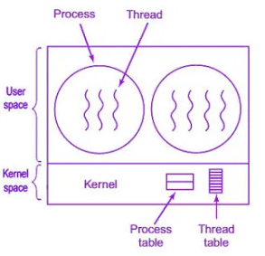
Kernel Threads:
Supported by the Kernel
Kernel performs thread creation,
scheduling and management in kernel space.
Slower to create and manage
Blocking system calls are no problem
Most OS’s support these threads
Examples: Windows XP/2000, Solaris, Linux, Tru64 UNIX, Mac OS X

Slide 26
Multi-Threading Models :
Some operating system provides a combined user level thread and kernel level thread facility. Solaris is a good example of this combined approach.
Multi-Threading models are three types.
• Many-to-One Model
• One-to-One Model
• Many-to-Many Model

Slide 27
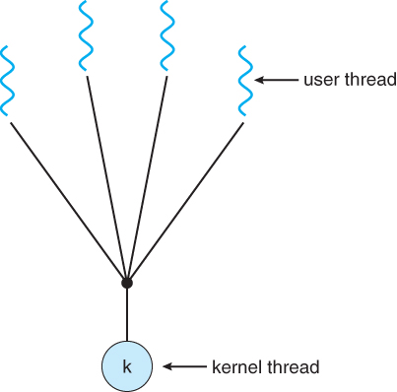
Many-to-One Model
In the many-to-one model, many user-level threads are all mapped onto a single kernel thread.
Thread management is handled by the thread library in user space, which is very efficient.
One thread blocking causes all to block.
Multiple threads may not run in parallel on multicore system because only one may be in kernel at a time.
Few system currently use this model
Example
Solaris green threads
GNU portable threads

Slide 28
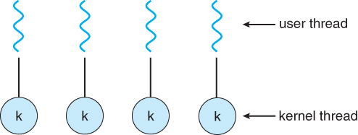
One-to-One Model
The one-to-one model creates a separate kernel thread to handle each user thread.
Each user-level thread maps to kernel thread.
Number of threads per process sometimes restricted due to overhead.
More concurrency than many to-to-one
Examples:
Windows
Linux
Solaris 9 and later

Slide 29
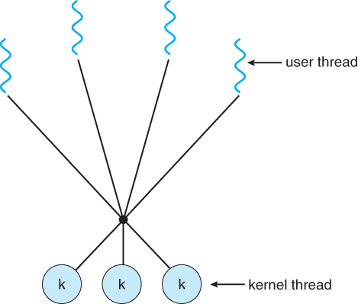
Many-to-Many Model
The many-to-many model multiplexes any number of user threads onto an equal or smaller number of kernel threads, combining the best features of the one-to-one and many-to-one models.
Allows many user level threads to be mapped to many kernel threads.
Allows operating system to create a sufficient number to kernel threads.
Users have no restrictions on the number of threads created.
Examples:
Solaris prior to Solaris 9.
Windows with ThreadFiber package

Slide 30
Process Scheduling
Which process is given control of the CPU and how long?
By switching the processor among the processes, the OS can make the computer more productive – basic objective for multiprogrammed operating systems

Slide 31
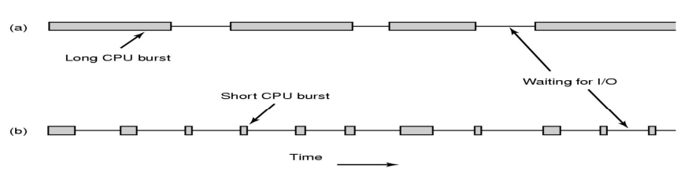
CPU-I/O Burst
Process execution consists of a cycle of CPU execution and I/O wait.
Process execution begins with a CPU burst that is followed by I/O burst, then another CPU burst, then another I/O burst........
CPU-bound: Processes that use CPU until the quantum expire.
I/O-bound: Processes that use CPU briefly and generate I/O request.
CPU-bound processes have a long CPU-burst while I/O-bound processes have short CPU burst.
Key idea: when I/O bound process wants to run, it should get a chance quickly.

Slide 32
When to Schedule
1. When a new process is created.
2. When a process terminates.
3. When a process blocks on I/O, on semaphore, waiting for child termination etc.
4. When an I/O interrupt occurs.
5. When quantum expires.
Once a process has been given the CPU, it runs until blocks for I/O or termination is known as non-preemptive, otherwise it is preemptive.

Slide 33
Scheduler
A scheduler is a type of system software that allows you to handle process scheduling.
Scheduler is an OS program or module that selects the next job to be admitted for execution.
There are three types of scheduler:
Long-term scheduler
Short term scheduler
Medium term Scheduler
Long Term Scheduler
Long term scheduler is also known as a job scheduler. This scheduler regulates the program and select process from the queue and loads them into memory for execution. It also regulates the degree of multi-programing.

Slide 34
Short Term Scheduler
Short term scheduling is also known as CPU scheduler. The main goal of this scheduler is to boost the system performance according to set criteria. This helps you to select from a group of processes that are ready to execute and allocates CPU to one of them. The dispatcher gives control of the CPU to the process selected by the short term scheduler.
Medium Term Scheduler
Medium-term scheduling is an important part of swapping. It enables you to handle the swapped out-processes. In this scheduler, a running process can become suspended, which makes an I/O request.
Dispatcher
• Low level mechanism.
• Responsibility: Context switch
• Save execution state of old process in PCB.
• Load execution state of new process from PCB to registers.
• Change the scheduling state of the process (running, ready, blocked)
• Switch from kernel to user mode.

Slide 35
Scheduling Criteria
There are different criteria to select the best algorithm in particular situation and environment
CPU utilization: Average Fraction of time during which CPU is busy, executing either user programs or system modules. (higher to better)
Throughput: the number of process that are completed per unit time.
Turnaround Time: Total time elapsed from time of job submitted to the time job or process is completed.
TAT= Process finish time-Process arrival time
Waiting Time: Amount of time a process has been waiting in the queue.
WT= TAT-Processing time
Response time: Amount of time it takes from when a request was submitted until the first response is produced not output

Slide 36
Scheduling algorithms
First-Come First-Serve (FCFS)
First come first serve (FCFS) scheduling algorithm simply schedules the jobs according to their arrival time.
The job which comes first in the ready queue will get the CPU first.
Easily implemented, by managing a simple queue or by storing time the process was received. Fair to all processes.
Problems: No guarantee of good response time., Large average waiting time., Not applicable for interactive system.
Consider the following set of process that arrives at time 0, with length of CPU burst given in milliseconds
Process | CPU Burst time
p1 | 24
p2 | 3
p3 | 3

Slide 37
Case-1: When p1, p2, p3 arrive in order p1→ p2→p3.
Gantt chart:
Turn Around Time = Completion Time - Arrival Time
Waiting Time = Turnaround time - Burst Time
waiting time for P1=0
waiting time for p2=24
waiting time for p3=27
AWT= (0+24+27)/3= 17 ms
ATAT=(24+27+30)/3=27 ms
0
24
27
30
P1
P2
P3

Slide 38
Shortest Job First (SJF)
SJF selects the process with shortest expected processing time. The processing times are known in advanced.
The decision policies are based on the CPU burst time.
Advantages:
Reduces the average waiting time over FCFS.
Favors shorts jobs at the cost of long jobs.
Problems:
Estimation of run time to completion. Accuracy?
Not applicable in timesharing system.
Optimal for minimizing queuing time, but impossible to implement. Tries to predict the process to schedule based on previous history.

Slide 39

Example:
Consider the process P1,P2,P3 and P4 given in the table below, arrives for execution in same order , with arrival time 0 and given burst time , lets find average waiting time and turn around time using SJF scheduling algorithm.
Gantt Chart:
Process Burst Time
p1 21
p2 3
p3 6
p4 2

Slide 40
Average Waiting time =(11+2+5+0)/4
=4.5ms
Average Turnaround time= (32+5+11+2)/4
=12.5 ms
Process | Arrival time | Burst Time | Completion time | Turnaround time | Waiting time
P1 | 0 | 21 | 32 | 32-0=32 | 32-21=11
P2 | 0 | 3 | 5 | 5-0=5 | 5-3=2
P3 | 0 | 6 | 11 | 11-0=11 | 11-6=5
p4 | 0 | 2 | 2 | 2-0=2 | 2-2=0

Slide 41
Shortest-Remaining-Time-First (SRTF)
This Algorithm is the preemptive version of SJF scheduling.
In this scheduling algorithm, the process with smallest amount of time remaining until completion is selected to execute.
At the arrival of every process, the short term scheduler schedules the process with the least remaining burst time among the list of available processes and the running process.
Merits:
Low average waiting time than SJF.
Useful in timesharing.
Demerits:
Very high overhead than SJF.
Requires additional computation.
Favors short jobs, longs jobs can be victims of starvation.

Slide 42

Example: There are six jobs P1, P2, P3, P4, P5 and P6. Their arrival time and burst time are given below in the table.
Gantt chart:
Process | Arrival time | Burst time
P1 | 0 | 8
P2 | 1 | 4
P3 | 2 | 2
P4 | 3 | 1
P5 | 4 | 3
p6 | 5 | 2

Slide 43
Process | Arrival time | Burst Time | Completion time | Turnaround time | Waiting time
P1 | 0 | 8 | 20 | 20-0=20 | 20-8=12
P2 | 1 | 4 | 10 | 10-1=9 | 9-4=5
P3 | 2 | 2 | 4 | 4-2=2 | 2-2=0
P4 | 3 | 1 | 5 | 5-3=2 | 2-1=1
P5 | 4 | 3 | 13 | 13-4=9 | 9-3=6
P6 | 5 | 2 | 7 | 7-5=2 | 2-2=0
Average Waiting time(AWT) =(12+5+0+1+6+0)/6
= 4 ms
Average Turnaround time(ATAT) =(20+9+2+2+9+2)/6
=7.33 ms

Slide 44
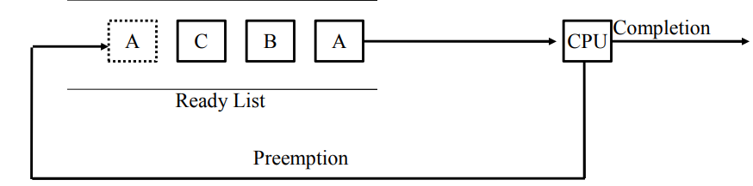
Round-Robin (RR)
This is the preemptive version of first come first serve scheduling.
Each process is assigned a time interval (quantum), after the specified quantum, the running process is preempted and a new process is allowed to run.
Preempted process is placed at the back of the ready list.
Advantages:
Fair allocation of CPU across the process.
Used in timesharing system.
Low average waiting time when process lengths very widely.
Poor average waiting time when process lengths are identical.

Slide 45
Quantum size:
If the quantum is very large, each process is given as much time as needs for completion; RR degenerate to FCFS policy.
If quantum is very small, system busy at just switching from one process to another process, the overhead of context-switching causes the system efficiency degrading.
Optimal quantum size?
Key idea: 80% of the CPU bursts should be shorter than the quantum. 20-50 msec reasonable for many general processes

Slide 46
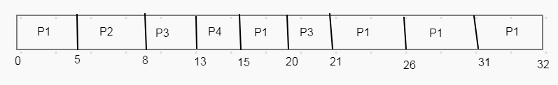
Consider there are four process P1,P2, P3 and P4 given in below table with arrival time 0 and given burst time. Compute Average waiting and Turnaround time using RR algorithm.(with time quantum=5)
Gantt chart:
Process | Burst Time
P1 | 21
P2 | 3
P3 | 6
P4 | 2

Slide 47
Average Waiting time=(11+5+15+13)/4
= 11ms
Average Turnaround time=(32+8+21+15)/4
=19 ms
Process | Arrival time | Burst time | Completion time | Turnaround time | Waiting time
P1 | 0 | 21 | 32 | 32-0=32 | 32-21=11
P2 | 0 | 3 | 8 | 8-0=8 | 8-3=5
P3 | 0 | 6 | 21 | 21-0=21 | 21-6=15
P4 | 0 | 2 | 15 | 15-0=15 | 15-2=13

Slide 48
Priority Scheduling
Priority Scheduling is a method of scheduling processes that is based on priority.
In this algorithm, the scheduler selects the tasks to work as per the priority.
The processes with higher priority should be carried out first, whereas jobs with equal priorities are carried out on a round-robin or FCFS basis.
Priority depends upon memory requirements, time requirements etc.
Priority scheduling can be of two types:
Preemptive Priority Scheduling: If the new process arrived at the ready queue has a higher priority than the currently running process, the CPU is preempted, which means the processing of the current process is stopped and the incoming new process with higher priority gets the CPU for its execution.
Non-Preemptive Priority Scheduling: In case of non-preemptive priority scheduling algorithm if a new process arrives with a higher priority than the current running process, the incoming process is put at the head of the ready queue, which means after the execution of the current process it will be processed.

Slide 49

Example : Non-preemptive Priority scheduling
Consider following four processes P1 to P4. Each process has its unique priority, burst time, and arrival time.
Gantt chart:
Process | Arrival Time | Burst Time | Priority
P1 | 0 | 10 | 3 (L)
P2 | 1 | 6 | 2
P3 | 3 | 2 | 1
p4 | 5 | 4 | 0 (H)

Slide 50
Average waiting time= (0+15+11+5)/4
=7.75 ms
Average turnaround time= (10+21+13+9)/4
=13.25 ms
Process | Arrival Time | Burst Time | Completion Time | Turnaround Time | Waiting Time
P1 | 0 | 10 | 10 | 10-0=10 | 10-10=0
P2 | 1 | 6 | 22 | 22-1=21 | 21-6=15
P3 | 3 | 2 | 16 | 16-3=13 | 13-2=11
P4 | 5 | 4 | 14 | 14-5=9 | 9-4=5

Slide 51

Example : Preemptive Priority scheduling
Consider following Three processes P1 to P3. Each process has its unique priority, burst time, and arrival time.
Gantt Chart
Process | Arrival Time | Burst Time | Priority
P1 | 0 | 10 | 3 (L)
P2 | 1 | 5 | 2
P3 | 2 | 2 | 1 (H)

Slide 52
Average waiting time = (7+2+0)/3
=3ms
Average Turnaround Time= (17+7+2)/3
=7.33 ms
Process | Arrival Time | Burst Time | Completion Time | Turnaround Time | Waiting Time
P1 | 0 | 10 | 17 | 17-0=17 | 17-10=7
P2 | 1 | 5 | 8 | 8-1=7 | 7-5=2
P3 | 2 | 2 | 4 | 4-2=2 | 2-2=0

Slide 53
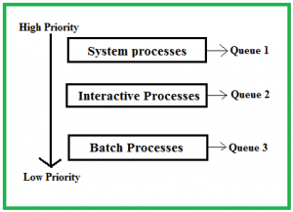
Multiple Queues Scheduling
A multi-level queue scheduling algorithm partitions the ready queue into several separate queues.
The processes are permanently assigned to one queue, generally based on some property of the process, such as memory size, process priority, or process type. Each queue has its own scheduling algorithm.
For example: separate queues might be used for foreground and background processes.
The foreground queue might be scheduled by Round Robin algorithm, while the background queue is scheduled by an FCFS algorithm.

Slide 54
Scheduling among the queues : What will happen if all the queues have some processes? Which process should get the CPU? To determine this Scheduling among the queues is necessary. There are two ways to do so
Fixed priority preemptive scheduling method – Each queue has absolute priority over lower priority queue. Let us consider following priority order queue 1 > queue 2 > queue 3.According to this algorithm no process in the batch queue(queue 3) can run unless queue 1 and 2 are empty. If any batch process (queue 3) is running and any system (queue 1) or Interactive process(queue 2) entered the ready queue the batch process is preempted.
Time slicing – In this method each queue gets certain portion of CPU time and can use it to schedule its own processes. For instance, queue 1 takes 50 percent of CPU time queue 2 takes 30 percent and queue 3 gets 20 percent of CPU time.

Slide 55

Example: Consider below table of four processes under Multilevel queue scheduling. Queue number denotes the queue of the process.
Priority of queue 1 is greater than queue 2. queue 1 uses Round Robin (Time Quantum = 2) and queue 2 uses FCFS.
Below is the gantt chart of the problem :
Process | Arrival Time | Burst Time | Queue Number
P1 | 0 | 4 | 1
P2 | 0 | 3 | 1
P3 | 0 | 8 | 2
P4 | 10 | 5 | 1

Slide 56
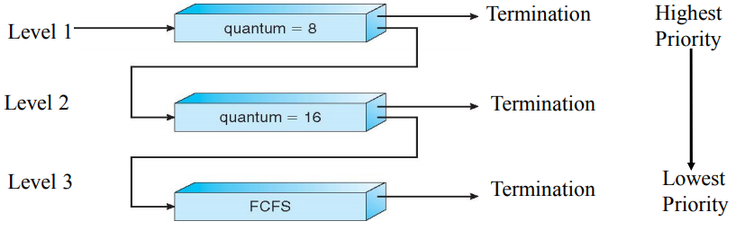
Multilevel Feedback Queue Scheduling
MFQ implements multilevel queues having different priority to each level (here lower level higher priority), and allows a process to move between the queues.
If the process use too much CPU time, it will be moved to a lower-priority queue.
Each lower-priority queue larger the quantum size. Each queue may have its own scheduling algorithm.

Slide 57
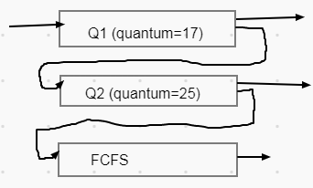
Example : consider below table of four process under multilevel feedback queue scheduling . MFQ scheduler with three queue Q1(Round Robin with time quantum 17), Q2(Round Robin with time quantum 25), Q3(FCFS).
Solution: Gantt chart:
Process | Burst Time | Arrival time
P1 | 53 | 0
P2 | 17 | 0
P3 | 68 | 0
P4 | 24 | 0

Slide 58
Average waiting Time = (83+17+94+101)/4
= 73.75ms
Average Turnaround Time = (136+34+162+125)/4
= 114.25 ms
Process | Burst time | Arrival Time | Completion Time | Turnaround Time | Waiting Time
P1 | 53 | 0 | 136 | 136-0=136 | 136-53=83
P2 | 17 | 0 | 34 | 34-0=34 | 34-17=17
P3 | 68 | 0 | 162 | 162-0=162 | 162-68=94
P4 | 24 | 0 | 125 | 125-0=125 | 125-24=101

Slide 59
Thread Scheduling
When several processes each have multiple threads, we have two levels of parallelism present: processes and threads.
Scheduling in such systems differs substantially depending on whether user-level threads or kernel-level threads.
On most modern operating systems it is kernel-level threads—not processes— that are being scheduled by the operating system.
User-level threads are managed by a thread library, and the kernel is unaware of them

Slide 60
Let us consider user-level threads first. Since the kernel is not aware of the existence of threads, it operates as it always does, picking a process, say, A, and giving A control for its quantum.
The thread scheduler inside A decides which thread to run, say A1. Since there are no clock interrupts to multiprogram threads, this thread may continue running as long as it wants to.
If it uses up the process’ entire quantum, the kernel will select another process to run.
When the process A finally runs again, thread A1 will resume running.
It will continue to consume all of A’s time until it is finished. .

Slide 61
Now consider the case that A’s threads have relatively little work to do per CPU burst, for example, 5 msec of work within a 50-msec quantum.
Consequently, each one runs for a little while, then yields the CPU back to the thread scheduler.
This might lead to the sequence A1, A2, A3, A1, A2, A3, A1, A2, A3, A1, before the kernel switches to process B. This situation is illustrated in Figure (a).
The scheduling algorithm used by the run-time system can be any of the ones described above.
In practice, round-robin scheduling and priority scheduling are most common.

Slide 62
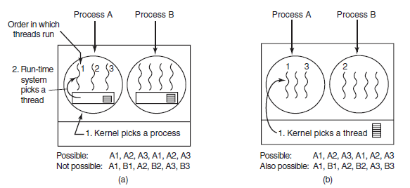
Figure (a) Possible scheduling of user-level threads with a 50-msec process quantum and threads that run 5 msec per CPU burst.
(b) Possible scheduling of kernel-level threads with the same characteristics as (a).

Slide 63
Now consider the situation with kernel-level threads. Here the kernel picks a particular thread to run.
It does not have to take into account which process the thread belongs to, but it can if it wants to.
The thread is given a quantum and is forcibly suspended if it exceeds the quantum.
With a 50-msec quantum but threads that block after 5 msec, the thread order for some period of 30 msec might be A1, B1, A2, B2, A3, B3, something not possible with these parameters and user-level threads.
This situation is partially depicted in Figure(b).

Slide 64
Process Synchronization
How to make sure two or more processes do not get into each other’s way when engaging in shared resources?
How to maintain the proper sequence when dependencies are presents?
Process synchronization – synchronize the process actions

Slide 65
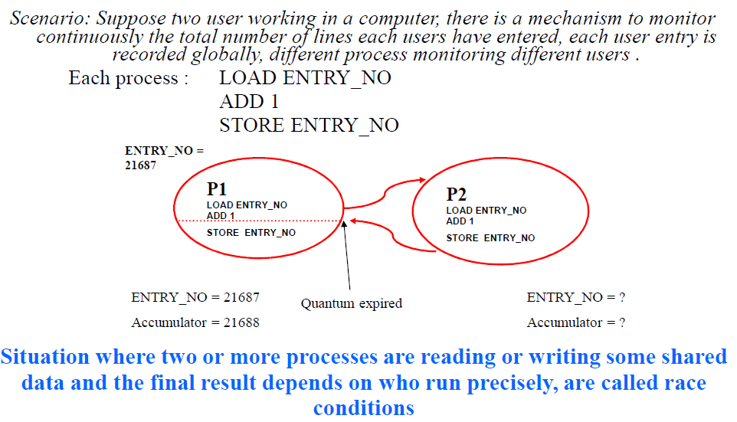
Race Conditions

Slide 66
Mutual Exclusion
Possibilities of race:
- many concurrent process read the same data.
- one process reading and another process writing same data.
- two or more process writing same data.
Solution: prohibiting more than one process from reading writing the same data at the same time- Mutual Exclusion.
Mutual Exclusion:
Some way of making sure that if one process is using a shared variables or files, the other process will be excluded from doing the same thing.

Slide 67
Critical Section Problem
Problem: How to avoid race?
Fact: The part of the time, process is busy doing internal computations and other things that do not lead to the race condition.
Code executed by the process can be grouped into sections, some of which require access to shared resources, and other that do not.
The sections of the code, common to all cooperating processes, that require access to shared resources are called critical section.

Slide 68
General structure of process
while(true){
entry_section
critical_section
exit_section
reminder_section
}
Solution to Critical Section Problem (CSP) must satisfy the following conditions:
1. No two processes may be simultaneously inside their critical sections (mutual exclusion).
2. No process running outside its critical section may block other process to enter into Critical Section. (Progress)
3. No process should have to wait forever to enter its Critical Section. (Bounded waiting)

Slide 69
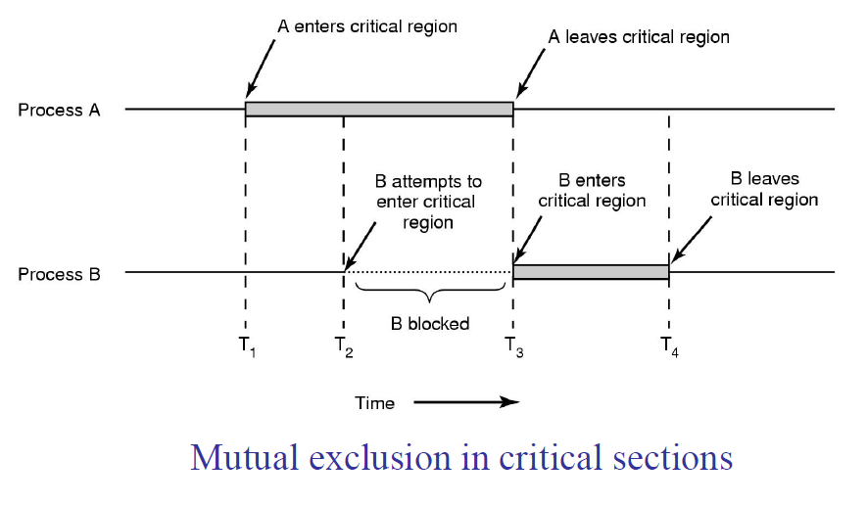
Critical Section Problem

Slide 70
Solution to CSP: Disabling Interrupts
Perhaps the most obvious way of achieving mutual exclusion is to allow a process to disable interrupts before it enters its critical section and then enable interrupts after it leaves its critical section.
By disabling interrupts the CPU will be unable to switch processes. This guarantees that the process can use the shared variable without another process accessing it.
But, disabling interrupts, is a major undertaking. At best, the computer will not be able to service interrupts for, maybe, a long time (who knows what a process is doing in its critical section?).
At worst, the process may never enable interrupts, thus (effectively) crashing the computer.
Although disabling interrupts might seem a good solution its disadvantages far outweigh the advantages.

Slide 71
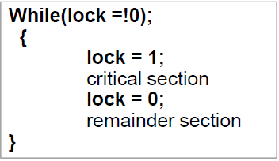
Solution to CSP: Lock Variables
In this mechanism, a Lock variable lock is used. Two values of lock can be possible, either 0 or 1. Lock value 0 means that the critical section is vacant while the lock value 1 means that it is occupied.
A single, shared (lock) variable (flag), initially 0.
When a process wants to enter its CR, it first test the lock. If the lock is 0, the process set it to 1 and enters the CR
If the lock is already 1, the process just waits until it becomes 0.
Advantages: seems no problems.
Problems:
Suppose that one process reads the lock and sees that it is 0, (due to quantum expire) before it can set lock to 1, another process scheduled, enter the CR, set lock to 1 and can have two process at CR (violates mutual exclusion).

Slide 72
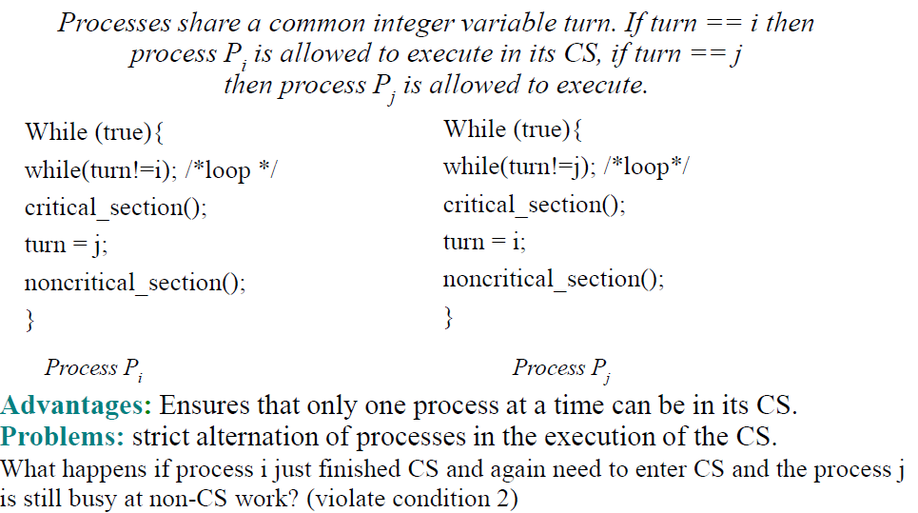
Solution to CSP: Strict Alternation

Slide 73
Solution to CSP: Peterson's Algorithm
The two processes share two variables: int turn; Boolean ready[2]
The variable turn indicates whose turn it is to enter the critical section
The ready array is used to indicate if a process is ready to enter the critical section.
ready[i] = true => Pi ready to enter its critical section
Algorithm for Process Pi
do {
ready[i] = true; /* Pi is ready for CS*/
turn = j; /* set turn to other*/
while (ready[j] ==true and turn == j) ; /* null statement*/
critical section
ready[i] = false;
remainder section
} while (1);

Slide 74
Advantages: Preserves all conditions.
Problems: difficult to program for n-processes system and less efficient
Solve the critical-section problem for two processes only

Slide 75
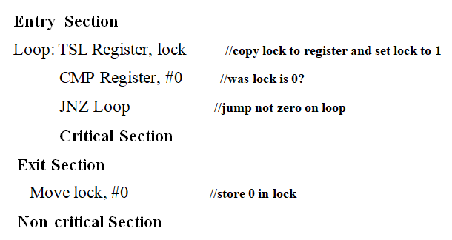
Solution to CSP: The TSL Instruction
TSL(Test And Set Lock) is a hardware solution of critical section problem.
To use the TSL instruction, we will use a shared variable, lock, to coordinate access to shared memory.
When lock is 0, any process may set to 1 using TSL instruction and then read or write shared memory.
When it is done, the process sets lock back to 0 using an ordinary move instruction.
When lock=1 no process can use it

Slide 76
Implementation of TSL using XCHG instruction
Entry_Section
Loop: Move Register, #1 //copy lock to register and set lock to 1
XCHG Register, lock
CMP Register, #0 //was lock is 0?
JNZ Loop //jump not zero on loop
Critical Section
Exit Section
Move lock, #0 //store 0 in lock
Non-critical Section

Slide 77
Sleep and Wake-up
Both Peterson and TSL solution have the defect of requiring Busy Waiting.
Busy waiting: When a process want to enter its CS, it checks to see if the entry is allowed, if it is not, the process just sits in a tight loop waiting until it is.
So we can have problem like
CPU time is wasted
Priority inversion problem
These problem can be solved by using Sleep and Wakeup primitives (System calls)

Slide 78
Sleep and Wakeup Producer-Consumer Problem
Two process share a common, fixed sized buffer.
• Suppose one process, producer, is generating information that the second process, consumer, is using.
• Their speed may be mismatched, if producer insert item rapidly, the buffer will full and go to the sleep until consumer consumes some item, while consumer consumes rapidly, the buffer will empty and go to sleep until producer put something in the buffer

Slide 79
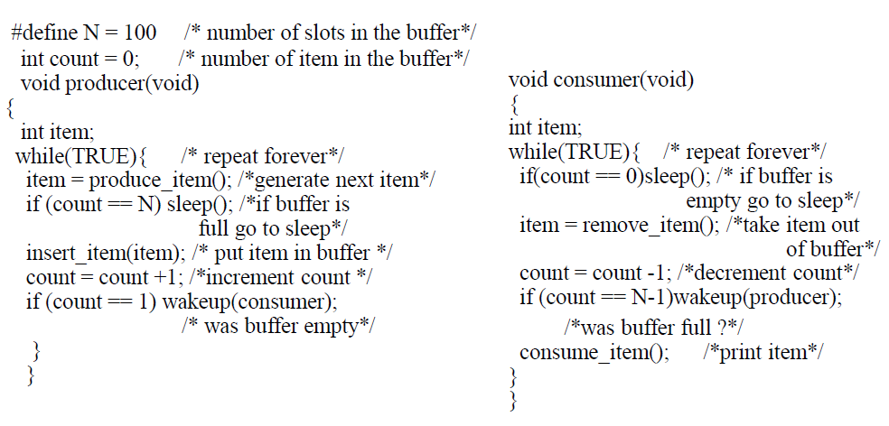
Example:

Slide 80
Sleep and Wakeup Producer-Consumer Problem
Problem:
What happen if buffer is empty, the consumer just reads count
and quantum is expired, the producer inserts an item in the buffer,
increments count and wake up consumer. The consumer not yet
asleep, so the wakeup signal is lost, the consumer has the count value
0 from the last read so go to the sleep. Producer keeps on producing
and fill the buffer and go to sleep, both will sleep forever.
Think: If we were able to save the wakeup signal that was lost........

Slide 81
Semaphore
E. W. Dijkstra (1965) suggested using an integer variable to count the number of wakeups, called a semaphore.
A semaphore is an integer variable which is accessed through two atomic operation wait and signal.
These operations are turned as ‘P’ for wait i.e. to test and ‘V’ for signal i.e. to increment
Semaphore S;
Wait(S)
{
while(S<=0);
S=S-1;
}
Signal(S)
{
S=S+1;
}

Slide 82
Uses of Semaphore
To solve critical section problem.
To decide order of process execution.
To manage the resources.
Int S=1;
do{
Wait(S);
Critical_section();
Signal(S);
Remainder_section();
}while(1)

Slide 83
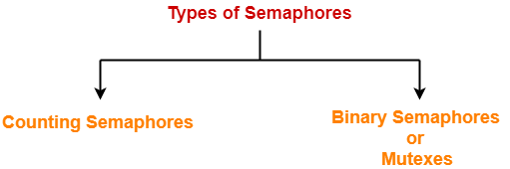
Types of Semaphore
Counting Semaphore: integer value can range over an unrestricted domain.
Full: counts the number of slots that are full
Empty: counts the number of slots empty.
Counting semaphore can be used for mutual exclusion and conditional synchronization.
Binary Semaphore: integer value can range only between 0 and 1; can be simpler to implement.
Binary semaphore is specially designed for mutual exclusion.

Slide 84
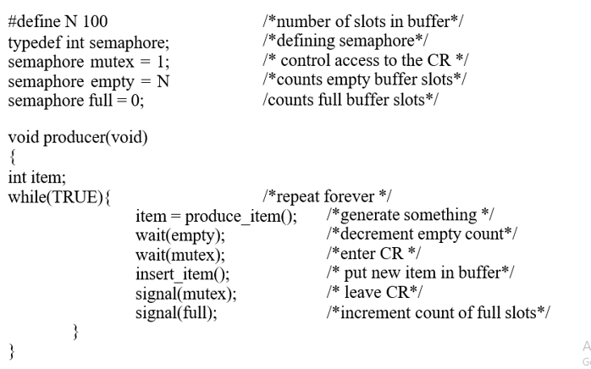
Semaphores Producer-Consumer using Semaphore

Slide 85
Semaphores Producer-Consumer using Semaphore
void consumer(void)
{
int item; while(TRUE){
wait(full); wait(mutex);
item = remove_item(); Signal(mutex);
Signal(empty); consume_item();
}
}
/*repeat forever*/
/*decrement full count */
/*enter CR*/
/*take item from buffer*/
/*leave CR*/
/*increment count of empty slots*/
/*print item*/

Slide 86

Deadlock
A process in a multiprogramming system is said to be in dead lock if it is waiting for a particular event that will never occur.
All automobiles trying to cross.
Traffic Completely stopped.
Not possible without backing some.
Deadlock is a situation where a set of processes are blocked because each process is holding a resource and waiting for another resource acquired by some other process

Slide 87
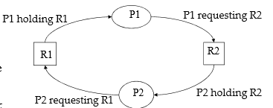
Resource Deadlock
A process request a resource before using it, and release after using it.
Request the resource.
Use the resource.
Release the resource.
If the resource is not available when it is requested, the requesting process is force to wait.
Most deadlocks in OS developed because of the normal contention for dedicated resources.
Process P1 holds resource R1 and needs resource R2 to continue; Process P2 holds resource R2 and needs resource R1 to continue – deadlock.
Key: Circular wait - deadlock

Slide 88
Conditions for Deadlock
Mutual Exclusion: Process claims exclusive control of resources they require.
Hold and Wait: Processes hold resources already allocated to them while waiting for additional resources.
No preemption: Resources previously granted can not be forcibly taken away from the process.
Circular wait: Each process holds one or more resources that are requested by next process in the chain.
A deadlock situation can arise if all four conditions hold simultaneously in the system.

Slide 89
Handling Deadlocks
Deadlock handling strategies:
We can use a protocol to prevent or avoid deadlocks, ensuring that the system never enter a deadlock state.
We can allow the system to enter a deadlock state, detect it, and recover.
We can ignore the problem all to gather, and pretended that deadlock never occur in the system
There are mainly four methods for handling deadlock.
1. Deadlock Prevention
2. Deadlock Ignorance(Ostrich Algorithm)
3. Deadlock Avoidance (Banker’s Algorithm)
4. Deadlock Detection and Recovery (Resource Allocation Graph)

Slide 90
Deadlock prevention
Fact: If any one of the four necessary conditions is denied, a deadlock can not occur.
Denying Mutual Exclusion:
Sharable resources do not require mutually exclusive access such as read only shared file.
Problem: Some resources are strictly non-sharable, mutually exclusive control required.
We can not prevent deadlock by denying the mutual exclusion
Denying Hold and Wait:
Resources grant on all or none basis;
If all resources needed for processing are available then granted and allowed to process.
If complete set of resources is not available, the process must wait set available.
While waiting, the process should not hold any resources.
Problem: Low resource utilization. Starvation is possible

Slide 91
Deadlock prevention
Denying No-preemption:
When a process holding resources is denied a request for additional resources, that process must release its held resources and if necessary, request them again together with additional resources.
Problem: When process releases resources the process may loose all its works to that point .
Indefinite postponement or starvation.
Denying Circular Wait:
All resources are uniquely numbered, and processes must request resources in linear ascending order.
The only ascending order prevents the circular.
Problem: Difficult to maintain the resource order; dynamic update in addition of new resources.
Indefinite postponement or starvation.

Slide 92
Deadlock Ignorance: Ostrich Algorithm
Fact: there is no good way of dealing with deadlock.
Ignore the problem altogether.
For most operating systems, deadlock is a rare occurrence. So the problem of deadlock is ignored, like an ostrich sticking its head in the sand and hoping the problem will go away.
Deadlock is rare, the cost of prevention or detection is high So, pretend as if there is no problem
The UNIX and Windows operating system take this approach

Slide 93
Deadlock Avoidance
Avoiding deadlock by careful resource allocation.
Decide whether granting a resource is safe or not, and only make the allocation when it is safe.
Need extra information in advanced, maximum number of resources of each type that a process may need.
The deadlock-avoidance algorithm dynamically examines the resource-allocation state to ensure that there can never be a circular-wait condition.

Slide 94
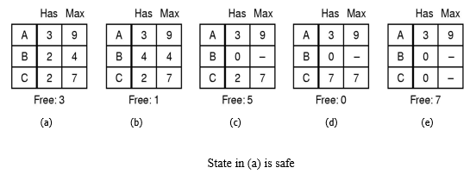
Deadlock Avoidance Safe and Unsafe States
A state is said to be safe if it is not deadlocked and there is a some scheduling order in which every process can run to completion.

Slide 95
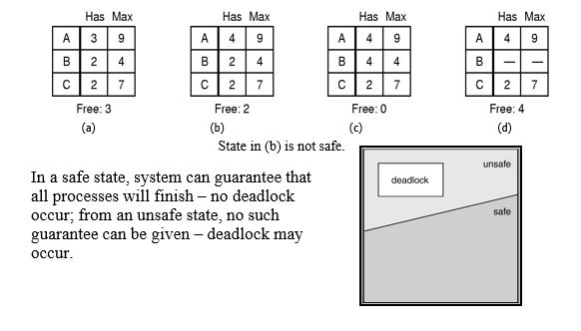
Deadlock Avoidance Safe and Unsafe States

Slide 96
Deadlock Avoidance Banker’s Algorithm
Models on the way of banking system to ensure that the bank never allocates its available cash such that it can no longer satisfy the needs of all its customers.
When a process request the set of resources, the system determine whether the allocation of these resources will left the system in safe state, if it will the resources are allocated, otherwise process must wait until some other process release enough resources.
Data structures: Available, Max, Allocation & Need.
need = max – allocation.

Slide 97
Deadlock Avoidance Banker’s Algorithm
finish_{i} = False;
for each process
if (need_{i} <= available && finish_{i}= false)
continue_{i};
available = available + allocation;
finish_{i} = True;
for each process
if (finish_{i} = True)
system is in safe state.
if (request_{i} <= need_{i})
{
if (request_{i} <= available)
{
available = available- request_{i};
allocation_{i} = allocation_{i} + request_{i};
need_{i} = need_{i}–request_{i};
}
else wait;
}
else
error;

Slide 98
Numerical Problem 1
Consider a system that contains five processes P1, P2, P3, P4, P5 and the three resource types A, B and C. Following are the resources types: A has 10, B has 5 and the resource type C has 7 instances.
Process | Allocation A B C | Max A B C | Available A B C
P1 | 0 1 0 | 7 5 3 | 3 3 2
P2 | 2 0 0 | 3 2 2
P3 | 3 0 2 | 9 0 2
P4 | 2 1 1 | 2 2 2
P5 | 0 0 2 | 4 3 3
Answer the following questions using the banker's algorithm:
1. What is the reference of the need matrix?
2. Determine if the system is safe or not.
3. What will happen if the resource request (1, 0, 0) for process P1 can the system accept this request immediately?

Slide 99
1. Solution: Context of the need matrix is as follows:
Need [i] = Max [i] - Allocation [i] Need for P1: (7, 5, 3) - (0, 1, 0) = 7, 4, 3 Need for P2: (3, 2, 2) - (2, 0, 0) = 1, 2, 2 Need for P3: (9, 0, 2) - (3, 0, 2) = 6, 0, 0 Need for P4: (2, 2, 2) - (2, 1, 1) = 0, 1, 1 Need for P5: (4, 3, 3) - (0, 0, 2) = 4, 3, 1
2. Solution: Apply the Banker's Algorithm:
Available Resources of A, B and C are 3, 3, and 2.
Now we check if each type of resource request is available for each process.
Step 1: For Process P1:
Need <= Available
7, 4, 3 <= 3, 3, 2 condition is false.
So, we examine another process, P2.
Process | Need A B C
P1 | 7 4 3
P2 | 1 2 2
P3 | 6 0 0
P4 | 0 1 1
P5 | 4 3 1

Slide 100
Step 2: For Process P2:
Need <= Available
1, 2, 2 <= 3, 3, 2 condition true
New available = available + Allocation
(3, 3, 2) + (2, 0, 0) => 5, 3, 2
Similarly, we examine another process P3.
Step 3: For Process P3:
P3 Need <= Available
6, 0, 0 < = 5, 3, 2 condition is false.
Similarly, we examine another process, P4.
Step 4: For Process P4:
P4 Need <= Available
0, 1, 1 <= 5, 3, 2 condition is true
New Available resource = Available + Allocation
5, 3, 2 + 2, 1, 1 => 7, 4, 3
Similarly, we examine another process P5.

Slide 101
Step 5: For Process P5:
P5 Need <= Available
4, 3, 1 <= 7, 4, 3 condition is true
New available resource = Available + Allocation
7, 4, 3 + 0, 0, 2 => 7, 4, 5
Now, we again examine each type of resource request for processes P1 and P3.
Step 6: For Process P1:
P1 Need <= Available
7, 4, 3 <= 7, 4, 5 condition is true
New Available Resource = Available + Allocation
7, 4, 5 + 0, 1, 0 => 7, 5, 5
So, we examine another process P2.

Slide 102
Step 7: For Process P3:
P3 Need <= Available
6, 0, 0 <= 7, 5, 5 condition is true
New Available Resource = Available + Allocation
7, 5, 5 + 3, 0, 2 => 10, 5, 7
Hence, we execute the banker's algorithm to find the safe state and the safe sequence like P2, P4, P5, P1 and P3.
3. Solution:
For granting the Request (1, 0, 2), first we have to check that Request <= Available, that is (1, 0, 2) <= (3, 3, 2), since the condition is true. So the process P1 gets the request immediately.

Slide 103
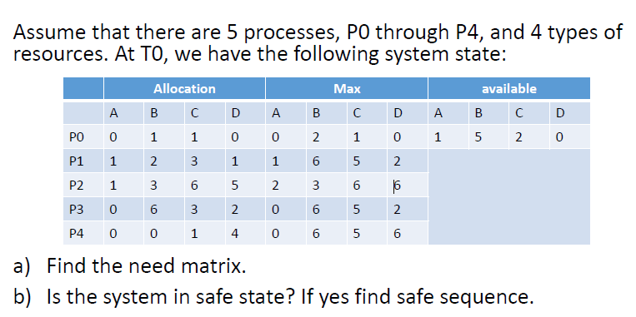
Numerical Example-2

Slide 104
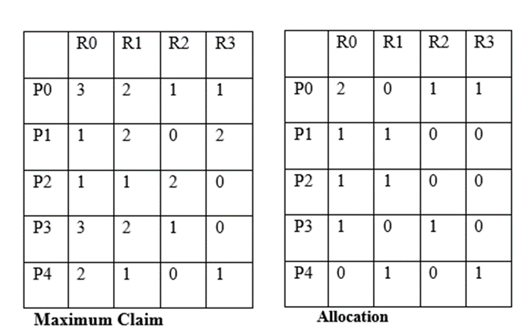
Numerical Example-3
Consider a System with 5 concurrent processes (P0,P1,P2,P3,P4) and 4 resource types (R0,R1,R2,R3).The number of instance of each resource type in the system are 6,4,4,2 respectively. Allocation table and maximum claim table are as follows:
Is the state safe? If so, Show the safe execution of processes

Slide 105
Problem with Banker’s Algorithm
It requires fixed number of resources, some processes dynamically change the number of resources
It requires the number of resources in advance It is very difficult to predict the resources in advance
This algorithm predicts all process returns within finite time, but the system does not guarantee it

Slide 106
Deadlock Detection and Recovery
Instead of trying to prevent or avoid deadlock,
system allow to deadlock to happen,
and recover from deadlock
when it does occur.
Hence, the mechanism for deadlock detection
and recovery from deadlock required.

Slide 107
Deadlock Detection
It is the process of actually determining that a deadlock exists and identifying the processes and resources involved in the deadlock
The basic idea is to check allocation against resource availability for all possible allocation sequences to determine if the system is in deadlocked state
Once the deadlock is detected, then it should be recovered

Slide 108
RAG(Resource Allocation Graph)
The resource allocation graph is the pictorial representation of the state of a system As its name suggests, the resource allocation graph is the complete information about all the processes which are holding some resources or waiting for some resources
It also contains the information about all the instances of all the resources whether they are available or being used by the processes
In Resource allocation graph, the process is represented by a Circle while the Resource is represented by a rectangle.

Slide 109
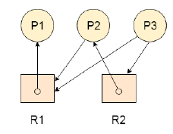
Let's consider 3 processes P₁ , P₂ and P₃ and two types of resources R₁ and R₂ The resources are having 1 instance each According to the graph, R₁ is being used by P₁ , P₂ is holding R₂ and waiting for R₁ and P₃ is waiting for R₁ as well as R₂
The graph is deadlock free since no cycle is being formed in the graph

Slide 110
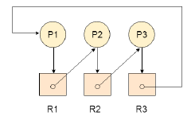
Deadlock Detection using RAG
If a cycle is being formed in a Resource allocation graph where all the resources have the single instance then the system is deadlocked
In Case of Resource allocation graph with multi instanced resource types, Cycle is a necessary condition of deadlock but not the sufficient condition
The following example contains three processes P1, P2, P3 and three resources R1, R2 and R3. All the resources are having single instances each.
If we analyze the graph then we can find out that there is a cycle formed in the graph since the system is satisfying all the four conditions of deadlock

Slide 111
Recovery from Deadlock
What do next if the deadlock detection algorithm succeed?
– recover from deadlock.
By Resource Preemption
Preempt some resources temporarily from a processes and give these resources to other processes until the deadlock cycle is broken.
Problem:
Depends on the resources.
Need extra manipulation to suspend the process. Difficult and sometime impossible.

Slide 112
Recovery from Deadlock
By Process Termination
Eliminating deadlock by killing one or more process in cycle or process not in cycle.
Problem:
If the process was in the midst of updating file, terminating it will leave file in incorrect state.
Key idea: we should terminate those processes the termination of which incur the minimum cost.

Slide 113
CASE STUDY
Process and thread management in real-time systems .
Operating systems for the Internet of Things (IoT)
Operating system support for mobile and embedded devices

